Slide 1
LatentView Analytics
Case Studies: 25-50
March, 2018

Slide 2

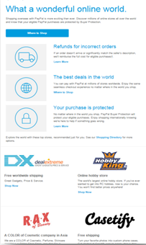
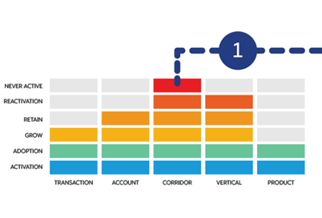

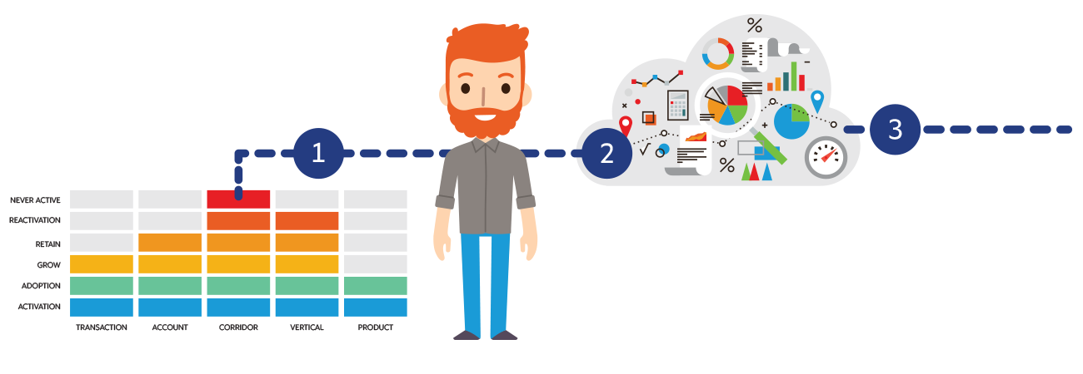
Integrated & Customized Campaign Activation for Higher Revenue
Leading Online Payments Company
The Problem:
While the highly engaged user transacted in 10-12 verticals, the average user only used the customer’s payment services in 3 verticals and this gap presented a significant revenue upside opportunity
The “Before” State
LatentView Solution
The “After” State
Campaigns were managed manually and were developed and executed based on general product-based marketing strategies by different marketing teams
Developed an automated platform for managing campaigns, which were customized through dynamic selection of best offers and messages for each customer based on their life stage
Customized campaigns resulted in significant number of incremental transactions for the average user (footprint increased from 3 to 8 verticals) which netted an additional revenue of $7.5 million
Segment Customer by Dimension and Life Stage
Select Best campaign using Optimization Engine
Message block dynamically selected for each customer
Adoption
2
3
Reactivation
Best campaign is selected for customer based on multiple criteria & Channel
Channel Dimension
Initiative Target method
Lifecycle stage
The Next Best Offer (NBO) Engine determines the best offers from the offer repository that are most relevant for customer.
Profiling customer by dimension and life stage.
Notes:
PayPal LVM
Business Objective:
Manage customer campaigns more efficiently based on various life time stages of customer to get high customer lifetime value.
LatentView Solution:
Dimensions:
Transaction – Drive overall Txn velocity
Account – Drive is to ensure account is RTT, Manage Funding Mix
Vertical – Drive Txns in New Verticals and channel MS/MP
Product – Drive Product Adoption and drive Txns in new products
Corridor – Drive cross border Txns and drive corridor activity

Slide 3
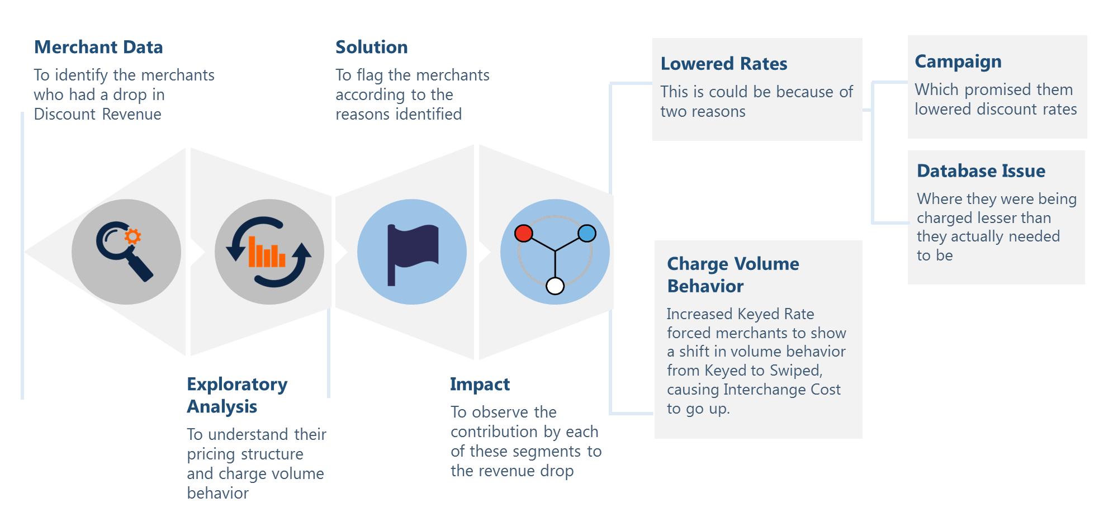



Behavioral Segmentation to Arrest Revenue Leakage
Leading SMB Financial Software & Payments Processing Company
The Problem: In the payments business, delays in responding to changes in customer behavior can lead to significant revenue loss
The “Before” State
LatentView Solution
The “After” State
Client and LatentView team maintaining the business performance dashboards noticed revenue leakage to the tune of USD 2.09 Mn. but were unaware of the reasons for the sudden monthly revenue drop
Behavioral segmentation based rapid diagnostic analysis was performed to identify the source(s) of revenue leak along with the reasons through structured data driven root-cause analysis
Merchant behavior shift (keyed to swiped) was identified as the key reason for revenue leak and rate slabs were instituted for keyed and swiped volumes separately which addressed USD 1.73 Mn (~83%) of the revenue leak
Campaign
Shifted Payments to Swiped Mode due to mild increase in keyed mode processing rates
Behavior Shift
No Change
Revenue Leak
Decrease
25%
83%
Merchants by Payment Volume
55%
Increase
17%
20%
1.73 Mn
Revised Rate Slabs
Notes:
Intuit – Revenue Leakage Analysis
Business Context
A leading financial software provider and payment processing company wanted to identify the reasons behind the drop in their revenue for a particular month for a specific product offering segment
LV Solution
Identified the group of merchants contributing to negative revenue
Segmented them based on their transactional behavior as – Incorrect Rates & Volume Shift Behavior segments (consistent with the formula for revenue)
Performed a merchant level analysis to identify their impact
Business Impact
Identified the issues with the database in terms of the rates they were being charged
Identified the behavioral pattern of the merchants between Swiped & Keyed Volume, which caused a revenue impact of 1.15M
Revenue Impact Split:
Out of 116 k active merchants, 29k merchants showed a revenue drop from 3.01% to 2.69%
Out of the 29k, 11k merchants showed volume shift from keyed (low cost) to swiped (high cost) resulting in a 1.15M revenue drop.
The earlier mix of keyed to swiped was 30:70 which changed to 50:50 post the new pricing scheme.
9k merchants were being charged lower rates accounting for 0.18% revenue drop i.e. 580k
7.8k merchants were part of a campaign that lowered the revenue from 680k to 322k

Slide 4
Amplifying profit by Optimizing Bid Rates for ‘First spots’
Leading Travel Website
The Problem: In the OTA industry, securing first spots on travel aggregator sites at optimal rates has big impact on overall profitability
The “Before” State
LatentView Solution
The “After” State
Bidding rates set manually based on intuitions & experience led to either expensive over-bidding or underbidding which reduced transaction volumes by 50% in half of the major markets upon drop in bid spot
Developed a tool which analyzed the number of quoters, transactions and purchase rates at days to arrival level for each city to forecast the most optimized bids for ‘first spots’ on travel aggregator websites
Net annual financial impact of $532k with the aid of cost reduction (optimized bids) of $204k and increase in transactions (higher first spot ad placements) of $328k
Automated Forecasting
Revised Bids for Top Markets
X: Average of Historical Bids Y: Actual First Spot Bid Z: Forecasted Bid
Z: 0.54 < X: 1.2 < Y: 2.09 → Revised Bid = 2.09
Z: 2.73 < X: 5.27 = Y: 5.27 → Revised Bid = 2.73
SAMPLE USE CASE
X: Average CPC; Y: First Spot Bid; Z: Breakeven CPC
Past
Quoters
Past Txns
31 Cities
(21 Standalone & 10 Clusters)
4 Days to Arrival
Buckets
Alpha
Past Purchase
Rate
$ 328 k
$ 204 k
Cost Savings (Optimized Bids)
Incremental Revenue (Better Ad Spots)
Forecasted Quoters, Transactions,
Purchase Rate
$ 532 k
Total Savings
Notes:
Hotwire- OPM bidding
Business Objective:
Minimize the bidding cost to reduce advertisement cost and higher conversion rate by getting the first spots.
LatentView Solution:
K-means clustering was used and 2,514 cities were put under 10 clusters.
Entire Forecasting process which uses exponential smoothing is automated and acts a tool for prediction.
This tool iterates through every city at each DTA(Days to arrival) level and does prediction for the upcoming week
We get the forecasted Quoters, Txns and PR as a result and the tool also calculates the breakeven CPC for each City * DTA combination.
Quoters : No. of people who will hit the hotwire site
Transaction : No. of people who transit on hotwire after redirecting
Purchase Rate : Transaction/Quoters

Slide 5
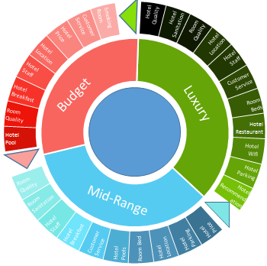
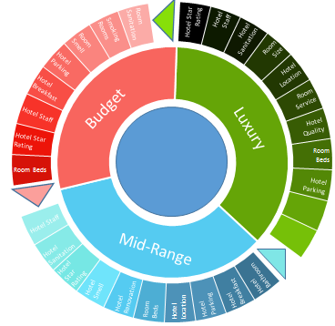







Driving Customer Loyalty through Net Promoter Score (NPS) Analysis
US-based Leading Travel Website
The Problem:
Given the high customer acquisition cost in the highly competitive online travel industry, establishing & nurturing customer loyalty can lead to higher profits
The “Before” State
LatentView Solution
The “After” State
Insights in to extent of customer loyalty in the OTA space was limited and the levers available to move customer loyalty were not known
Identified the drivers of NPS by performing text mining on post purchase surveys and quantified the influence NPS drivers on customer loyalty using regression approach
Based on NPS drivers analysis, company revised hotel ratings, improved results sorting & re-focused marketing promotions which resulted in 15% increase in repeat transactions from existing customers
Customer Loyalty by NPS
Drivers that enhance and detract NPS score
NPS Score increases by
10.6% - Avg. length of stay Inc. by 1 day
Identify Drivers of NPS
Promoters
Detractors
4% - Stay includes a weekend
How can we move NPS?
4.1% - No. of days-to-travel Inc. by 1 day
Notes:
Hotwire- NPS
Business Objective:
Identify the drivers for NPS score and the impact of NPS on repeat purchases
LatentView Solution:
Identified the factors driving NPS by text mining of NPS survey feedback
Identified the drivers of NPS and quantified their influence using a regression approach
Process:
Data collected from post purchase survey Text mining on survey data to identify detractors and promoters for NPS score.
Identified the drivers of NPS and quantified their influence using a regression approach
Business benefit: Helped ascertain the importance of the post purchase survey and tracking of customer NPS level
Client used the findings to identify entire neighbourhoods where inventory needed to be improved and build a checklist of features to rate future partners and suppliers
Significant Effect:
Solution provide a potential increase of 15% repeat transactions of the customer

Slide 6
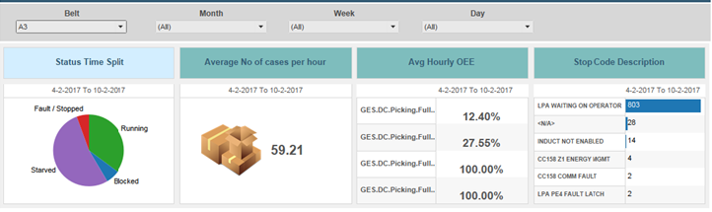
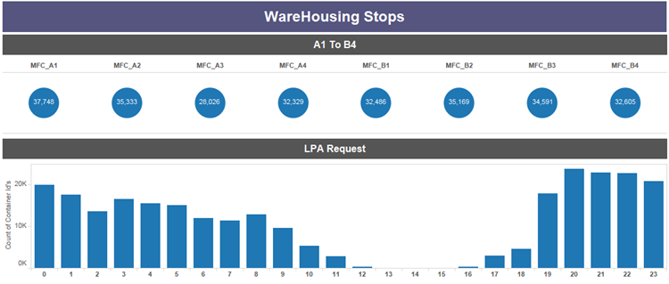
Process Mining to Improve Manufacturing Throughput
Leading Snacks & Beverage Manufacturer
Key Digital Trends in the Auto Industry
The Problem: Difficulty in identifying bottlenecks in high throughput assembly lines as the process is non-linear in nature.
The “Before” State
LatentView Solution
The “After” State
Cases processed per hour were at a very low value of ~400 / hr as against the expected target of 800 / hr and the root cause of the problem was not known.
Utilized Process Mining to identify bottlenecks like:
18% of cases stuck at carton sorted area
20% of cases diverted back to carton sorted area from the aisle lift pickup as they arrived at wrong aisle
Cases processed increased to 680/hr./ door
Inventory levels reduced from 48 to 45 days
Savings of $1 MN per packaging line
KPIs for LPA, PickBelt, PickAcc & Distmerge:
No. of cases processed on a hourly basis:
Notes:
Pepsico – Warehousing Stops
Business Objective:
Understand the reason why LPA falls short of expected target of 800 cases/hr./ door
Develop a dashboard to identify and compare the scenarios of LPA performance
LV Solution:
Identification of processes around LPA which might have a significant impact on LPA performance
Use Disco (Process Mining tool) to find the bottle necks in the warehouse process
Pick Belt not sending enough cases to Pick Acc.
Pick account is unable to process that many cases in time
Speed of LPA is reduced since distribution merge is at its full capacity (unable to take anymore cases)
Findings:
18% percent of cases are stuck at carton sorted area since its not able to map them to the exact aisle lift pickup area
20% percent of cases are being diverted back to carton sorted from the aisle lift pickup as they arrived at wrong aisle
Business Benefits:
Cases processed increased to 680/hr./ door
Inventory levels reduced from 48 to 45 days
Savings of $1 MN per packaging line

Slide 7
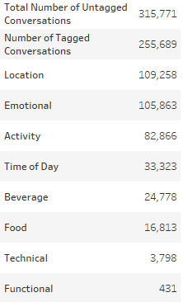
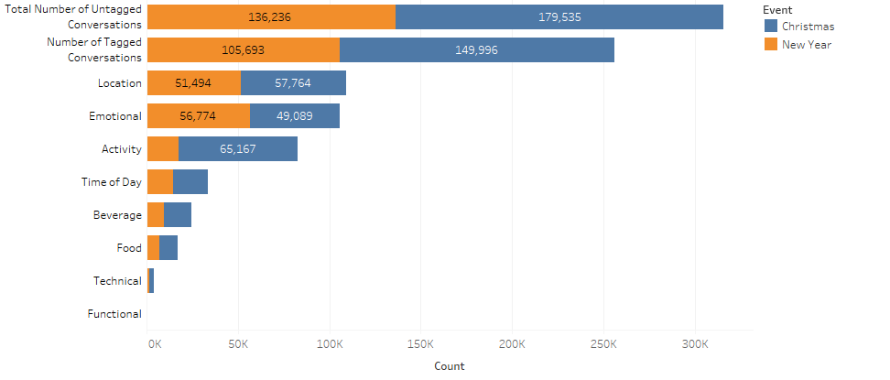



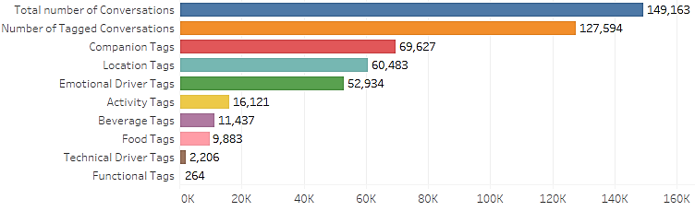



Events Analysis using Social Listening for Marketing Activation
Leading Snacks & Beverage Manufacturer
Key Digital Trends in the Auto Industry
The Problem: For food & beverage companies, specific events present a great opportunity to increase brand awareness & consumption but marketing efforts needs to be precisely targeted during that short available time window
The “Before” State
LatentView Solution
The “After” State
Customer wanted to have an in-depth understanding of beverage demand moments around specific events during the year so that the right marketing activation can be carried out in both digital and offline channels
10 Events were picked for social analysis which included comprehensive text mining (NLP) to understand emotional, functional, technical and contextual drivers around these events
Based on insights delivered, the company improved on dollar share across key events with the highlight being a significant $ increase during a period of 8 weeks after Thanksgiving which was a $158 MM opportunity
Functional Drivers
Emotional Drivers
Technical Drivers
Event:
Christmas & New Year
Yum - 49%
Happiness - 42%
Hot – 48%
Smell - 23%
Love - 10%
Cold - 17%
Thirsty - 13%
Favorite – 10%
Filled - 11%
Restored - 2%
Good - 8%
Sparkling - 7%
Taste - 1%
Great - 7%
Frozen - 6%
Top Food Items
Top Beverages
Top Activities
Event:
Thanksgiving
Turkey - 30%
Tea - 65%
Watching Movie - 45%
Gravy - 9%
Coffee - 13%
Playing - 21%
BBQ - 8%
Water- 7%
Partying- 12%
Pie - 4%
Wine - 5%
Music - 11%
Chocolate - 4%
Green Tea - 4%
Drinking - 4%
Notes:
Pepsico – Events Analytics using Social Listening for Marketing Activation

Slide 8





















Enhance Client Relationship using Machine Learning
Leading Asset Management Company in UK
The Problem: Post Brexit, the company was experiencing significant churn & disinvestment in their fund portfolio
The “Before” State
LatentView Solution
The “After” State
Accuracy of the current process to predict disinvestments in institutional clients was only 20% accurate. And on the wholesale side, there were no systematic way to target new financial advisors with appropriate funds
Developed a comprehensive view of contacts by combining data related to their interactions, servicing & product performance which acted as input into Machine Learning models to:
Predict disinvestment - Logistic Regression
Target Fund advisors - Look Alike models
Institutional Clients – Accurate predictions of disinvestments in 60% of the cases leading to retention of mandates worth 444 Million Pounds
Wholesale Clients – Better Targeting leading to a potential investment uplift of 50 Million Pounds
Contact / Account Profiling
Institutional Client Retention
Ability to quantify level of interactions across client and prospect base
Increase ability to predict redemptions by establishing a consistent global measurement standard
Data Sources
Data Sources
Unstructured Data
Structured Data
Meetings
Meetings Content
Engagement Score
Consultant Ratings
Fund Performance
Servicing Interactions
Analytic Process
Impact
Meetings
Calls
Webcasts
Events
Web Visits
CRM
Retention Model
Logistic Regression
Retention Model captures 40% more disinvestments than the current risk evaluation
Analytic Process
Engagement Score
Wholesale Target Audience – for Funds
Promote a broad fund diversification agenda by targeting advisers with a higher propensity to invest
Priority of Interaction
Quality of Interaction
Key Insights
Data Sources
18% disinvestment with account with no engagement
Market Share
Transactions
Marketing Interactions
Analytic Process
Impact
The investment probability increases from 31% to 89% as the driving engagement metrics increases
Look-Alike Model
Pearson Similarity Index
Investment uplift of >£50 Million (23.6%) is expected in the leads generated using investment behavior for the fund X
8
Notes:
Standard Life Investments – Enhancing Client & Marketing Relations
Business Objective
Digital transformation & Data driven strategy to drive engagement among both institutional & wholesale clients
Maintain appropriate levels of Relationship Management & Communication Contact with clients
Institutional Clients - Reduce retention risk & Disinvestments through optimum engagement
Whole Sale Clients - Drive product diversification (Cross sell) through optimum engagement & personalized “Next Buy Offer”
LV Solution
Assessed Analytics/Data maturity
Assessed Technology landscape & Execution feasibility
Harness Data for
Governance for client engagement – Account / Contact Profiling
Alerting at Actionable early stage – Client Retention
Campaign Prospecting – Target Audience Identification
Business Impact
1) Institutional Clients - Retention Model captures 40% more disinvestments than the current risk evaluation (Model identified £444 Mn out of £804 Mn
redemptions i.e. 40% more than current process)
2) Wholesale Clients - Investment uplift of >£50 Million (23.6%) is expected in the leads generated using investment behavior for the fund X

Slide 9

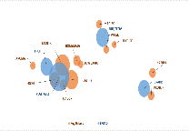



Emerging Social Media Trends Driving Product Development
Leading US Based Bakery Chain
The Problem: Early identification of flavor & ingredients trends can provide a significant first mover advantage and so it is important to latch onto it before competition
The “Before” State
LatentView Solution
The “After” State
Limited understanding of consumer emotional and functional drivers . Flavor / Ingredient trends were identified using expensive and time consuming surveys and focus groups.
Cataloged a list of all bread/muffin varieties & mined relevant social conversations to identify emerging flavors / ingredients and their associated drivers (emotional, functional)
Reduced time to market by 2x, identified emerging trends early on and catered to consumer emotions and excitement increasing product overall sales and ticket sizes.
Ingredient based bread Identification
Emerging and Seasonal Flavours
Levels of Granularity
Drivers Association
Text mining
Various Ingredient Combination Identification
Social Media Buzz Analysis
Holt-Winter’s Algorithm
Benchmarking
Bucketing into Different
Categories
Perception Analysis
Cross-Dimension Analysis
Intra-Dimension Analysis
380 Identified Flavours 100
238 Validation 63
Seasonal/Emerging
111 - 48
Bucketing
29-13
Fruit based breads are preferred twice as much as any other bread for Taste
Nuts & Seed based breads are closely associated with Vegan & Paleo diet. It is also preferred for its texture
TASTE
People looking for healthy choices of bread types prefer Vegetable based bread more than others
Close to half the conversations around Texture are associated with Nut & Seed based breads
Breads
Muffins
HEALTHY
Notes:
Ardent Mills – Bread Flavor Analysis

Slide 10
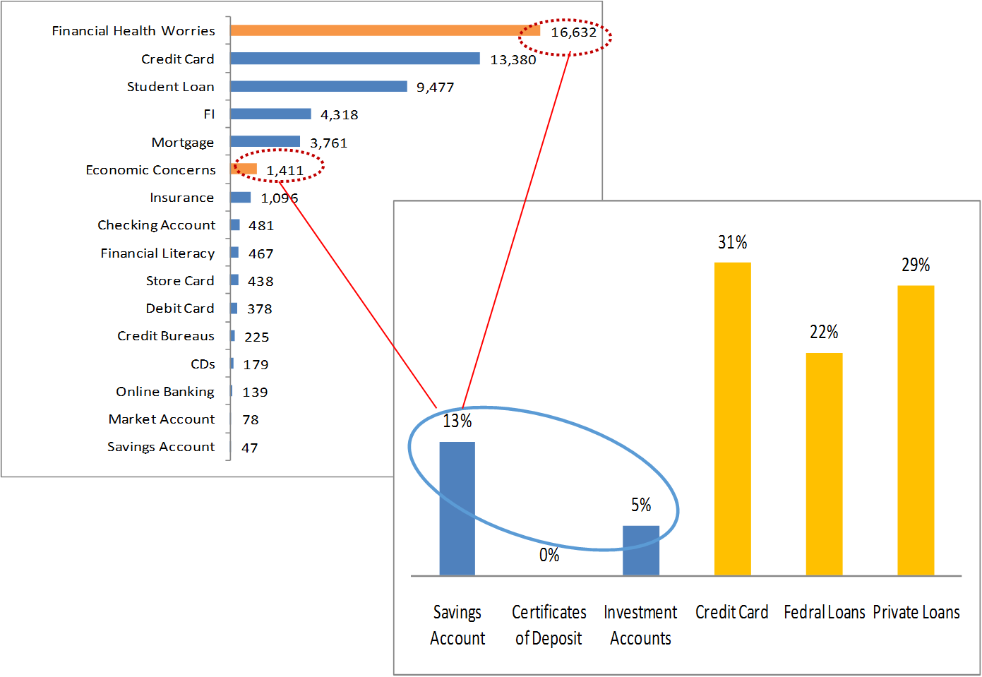
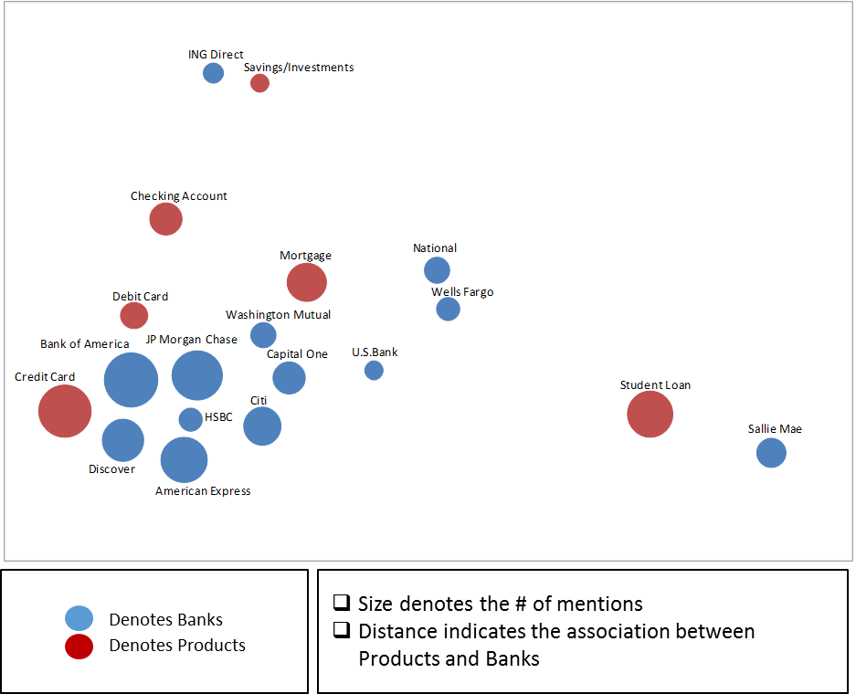



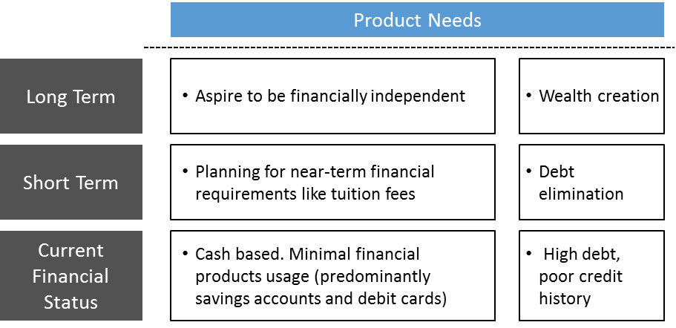
Social Media Analysis to Understand Youth Segment Banking Needs
One of the top 5 largest banks in the US
The Problem: In an industry trying to attract the young population, this company had a very low youth segment penetration
The “Before” State
LatentView Solution
The “After” State
The existing products were unable to capture the attention of the youth segment (35% of population) which had an earning potential of $3.5 trillion
Based on unbiased conversations sourced from social media, LatentView’s Natural Language Processing platform helped create a product association map for the youth segment
Youth segment had weak association across products with the credit card product line having high entry barriers
Checking, savings & Investment products lines are under served and hence present an opportunity
Data Collection
Data Cleaning
Need Space Analysis
Product Gap Analysis
Demand-Product Map
Internal Structured Data
Apply youth filters on collected dataset
Segmenting and analyzing the buzz ratings across age categories
Current economic concerns & financial health worries created buzz among youth
External Unstructured Data
Collate posts relevant to target Segment
(from websites identified through secondary research)
Indicated a market that will readily accept Savings & Financial Management products which are currently limited in the market
The Demand –Product mapping provided insights into the existing products and where they need to be positioned
Stop words elimination, language treatments
Notes:
US Bank – Social Media Analysis - Youth Segment Perception

Slide 11



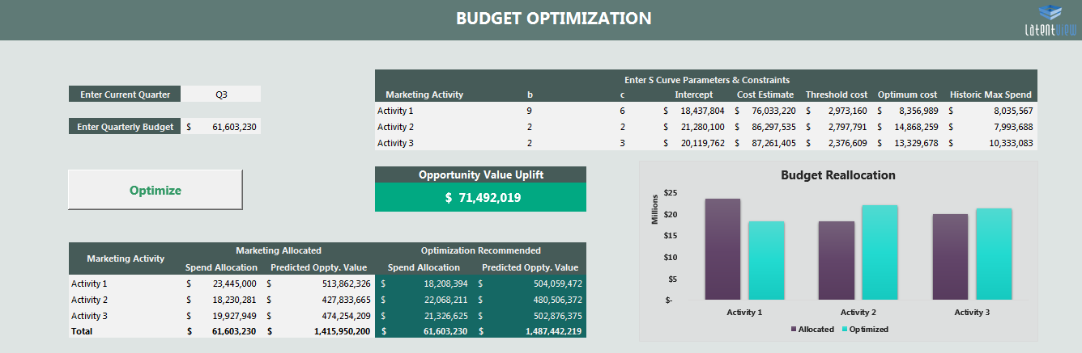






Self-Service Platform for Media Mix Modelling and Budget Optimization
Top Global Technology Solution & Service Provider
The Problem: Inefficient attribution of opportunity value between online and offline activities led to sub-optimal allocation of spends
The “Before” State
LatentView Solution
The “After” State
Client only had first touch attribution mechanism to study the impact of different marketing activities which did not provide insights in to the exact impact of all activities
Developed models using Ridge regression incorporating halo impact analysis to quantify cross activity effects and S Curves to identify optimal level of investments across multiple media vehicles
Client utilized the GUI based tool to optimally allocate budget across various activities which influenced an uplift of ~ $200 Million in Opportunity value annually
Modelling
S Curve & Optimization
Seasonality Flags – Using STL analysis
S-Curve: Media
S-Curve: Field
Stage 1
Stage 2
Gompertz Model : Y = b₀ + b₁$e^{−be_cX}$
Pipeline
Media
Events
Channel Marketing
Events
Field Marketing
Paid Search
Banner/ Display
Paid Social
Traditional Media
Outbound Calling
Others
Telemarketing
Digital
Others
Optimum
Retention Rate – Using Ad stock transformation
Threshold
S-Curve
Lag Effect of activities – By shifting data points
Halo Impact
Halo Impact
Outboards
Notes:
HP Enterprises – Media Mix Modeling

Slide 12


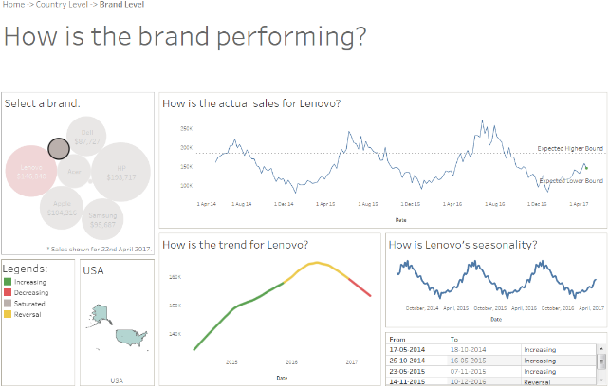


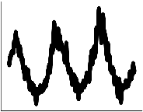






Machine Learning Driven Sales Trend Detection at Scale
Leading Transnational Consumer Goods Company
The Problem: In the CPG industry , the speed to detect sales trends accurately at the most granular SKU level across multiple product categories can be a big source of competitive advantage
The “Before” State
LatentView Solution
The “After” State
Detecting sales trends & anomalies across thousands of SKUs was a laborious, error-prone, time consuming activity taking almost 4-5 weeks to even get a rudimentary estimate
Built a Machine Learning, Rules & Notification engine to perform enhanced seasonal decomposition of time series (STLPlus) along with changepoint / breakpoint analysis on sales data, to identify & classify seasonal, trend components
Deep dive sales analysis output with notifications for over 10,000 SKUs in less than a day helped making timely market interventions in supply chain planning thus reducing stock-out rate by 5% & inventory costs by 2%
Data Validation
Trend
Data Cleaning
Seasonality
Data statistics
Tableau Dashboard
Noise (negligible)
Data Preprocessing
Decomposition
Change Detection
Classification
12
Azure ML Studio
Push
Notifications
Notes:
Unilever – Trend Classification & Anomaly Detection

Slide 13
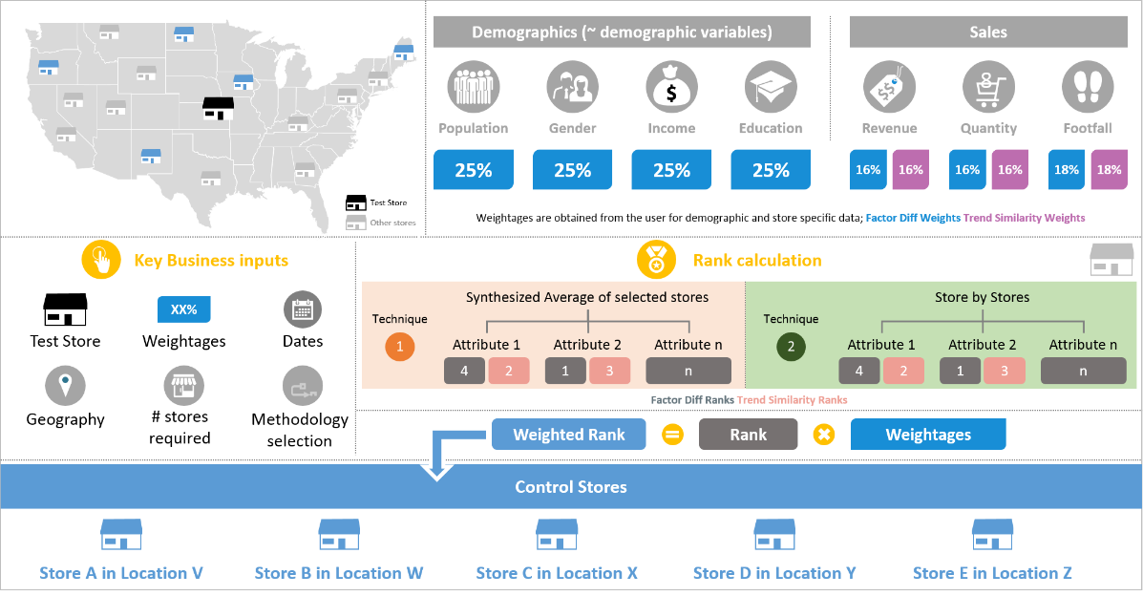
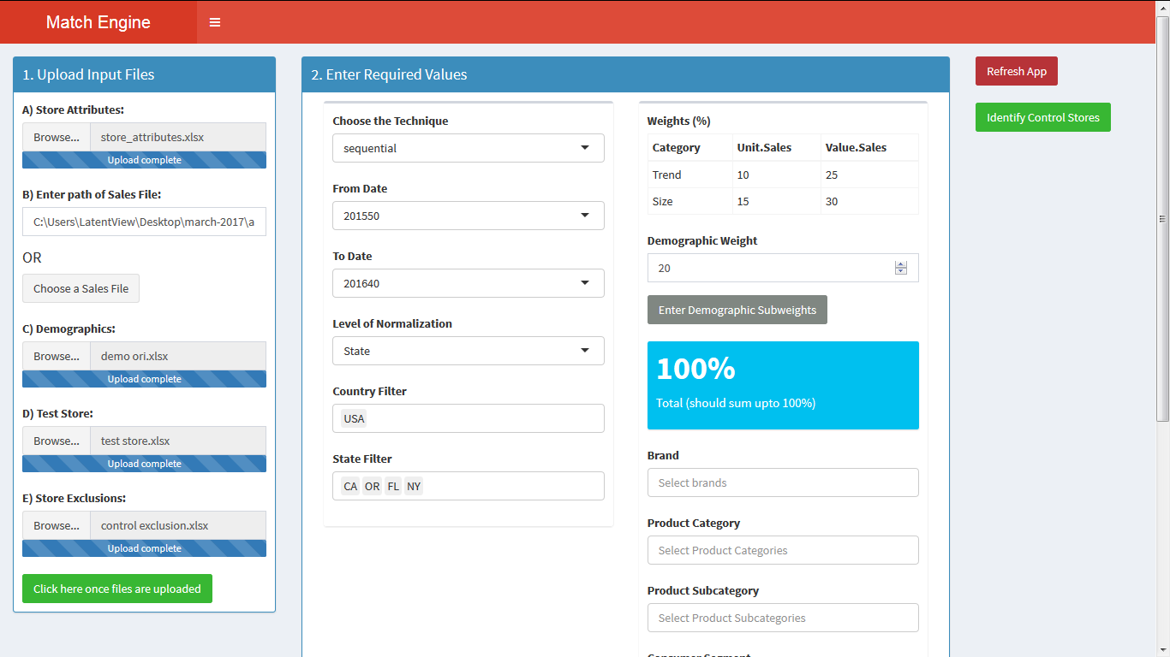
Store Identification for Campaigns using MatchView
Leading Apparel Retailer
The Problem: In the retail business, assessing the success of marketing campaigns using the right set of stores is critical to ensuring in making the investments in to the right set of campaigns
The “Before” State
LatentView Solution
The “After” State
Lack of systematic process and the time spent for identifying control stores was rendering the assessment of marketing campaigns difficult with several inconclusive results
Built a retail store match engine using a weighted factor difference and trend similarity algorithm to rank control stores and analyze campaign performance using ANCOVA
Reduced campaign turnaround time by over 90% and increased campaign success conclusiveness influencing $284 Mn. of marketing spend to right campaigns
Control Store Identification Process
Notes:
Levis - MatchView

Slide 14








Improving Marketing Effectiveness through Purchase Intent Modeling
Leading Global Software Company
The Problem: Understanding changes in purchase intent is very critical in the highly dynamic technology industry
The “Before” State
LatentView Solution
The “After” State
Understanding the drivers of purchase intent & customer satisfaction was limited as not all possible behavioural combinations could be explored effectively
Built a Azure ML - cloud based modeling automation framework that integrates data sources, generates 400,000 model combinations to show the drivers of purchase intent through intuitive PowerBI visualizations
Quick understanding of the changing purchase intent & drivers helped marketing team make right tweaks to their spend value of $1.6 billion thereby improving marketing ROI by 3-4% on an average
Modeling Automation Framework
Marketing Spend - Scenario Testing
Survey
In-Time
AE - 1.9%
APE - 4.4%
Effect of spends being dark in Q1
Out-Time
AE - 2%
APE - 4.4%
Sales
Iterating with 400K combinations to get final model
Store final model parameters & associated data for all products
Live visualization of model results & scenario testing
Mktg. Spend decisions
Forecast:
PI is expected to decline to 38% in the next fiscal yr. Q1, but stay at a constant of 43% over the next 3 quarters of the fiscal year.
Ad Spends
Scenario: Going dark in Q1 – If we stop spending $41 M will results in a 5% drop in the Purchase Intent (sales proxy)
Notes:
MSFT – CMR - Modeling Automation Framework
Application hosted in Microsoft App Portal:
https://appsource.microsoft.com/en-us/product/cortana-intelligence/latentview.latentview-maf?tab=Overview
Advantages of the Framework:
End-to-End automation (working on live feeds, bottleneck on client side). Results obtained at a click of a button.
Reduced the time spent in modelling from 1 week to 4 hours
Every data stored in Microsoft cloud servers
Using the full power of Machine learning for Modelling
Manual Errors drastically reduced
LatentView has come up with an entirely new model automation framework which helps in building thousands of models with an additional rule based engine layer that helps in choosing the best models. Latentview has built this solution for one of the leading Technology Companies, which develops, manufactures, licenses, support and sells computer software, consumer electronics, personal computers, and services. LatentView leverages MAF to tie data from multiple sources to provide a single stop solution to the stakeholders, perform analysis, generate insights and provide business recommendations.
The client’s Marketing team is primarily interested in understanding the effectiveness of their Advertising and Marketing budget in affecting consumer perceptions positively. . The primary data on consumer perceptions is obtained through surveys. LatentView’s MAF Solution would help stakeholders build statistical models to quantify the impact of spends and perceptions on the key metric. Additionally, stakeholders were interested in understanding the effectiveness of spends and to measure its impact at various levels of spends. This primarily helps to understand the inflection, optimal & saturation points of spends. The solution would also be used to forecast the key metric and test various scenarios by altering spends, to understand its impact on sales.
The standard approach used to take around one week to complete the above analysis and also had to churn out multiple cuts of the analysis. Additionally, for each combination (country, segment, time period, etc.), the entire process had to be repeated all over again. Since the client’s analytics team required support for multiple such requests, a robust solution which automates the entire process with substantial time reduction was the prime need of the hour.
MAF enables an end-to-end automation of the modeling process from variable selection, variable transformation, establishing relationships, feature selection, model building, model fine-tuning to selection of best models. The model outcomes are represented in a user interface.
The solution is developed as a modular framework to accommodate any future requirement changes. The user will also be able to select the dependent variable and the independent variables with which the model needs to be built. Additionally, there are options to select a subset of data for which we will need to run the model. The subset will be based on the date range selected and the population selected.
The user has the flexibility to select the model population, time period, target and predictor variables through the Azure ML interface. Azure ML fetches the data from the Azure SQL DB, transforms the data for establishing relationships and builds the model. From millions of models built, the best models are selected based on rule-based criteria. The final model results are stored in the DB and Power BI is used to visualize the model results.

Slide 15











Enhancing Customer Experience through Chatbots
Multinational e-commerce corporation
The Problem: Development and launch of chat-bot (for UK market) by client had teething issues, which required continuous monitoring and reporting on key chat-bot performance metrics
The “Before” State
LatentView Solution
The “After” State
Client spends ~ $150 million globally for customer service. Without the presence of a chat bot, high number of customer service related queries (20% of all queries) were escalated to human agents
Developed a dashboard which monitors performance of client’s newly launched chat-bot. Dashboard metrics identified engagement rate of the chat-bot by customers and number of chat disconnects, among others
Improved bot performance through analysis of call escalations & classifying reasons for escalation. Escalation rates dropped from 20% to 4.48%. Resolution rates jumped to 85%
Chat-bot metrics
Features & benefits
40%
Chat-bot was developed by client’s product development team to address queries related to product not received and returns
Adoption rate
Product not received & Returns
Escalation rate
Resolution rate
20%
Escalation rate
4.48%
Satisfaction score
Chat disconnects
0.9% | Adoption rate of chat-bot
4.48% | Escalation rate from chat-bot to human agents
85% | Capacity planning for escalations to human agents
91% | Average satisfaction score
Service level
Average handling time
Notes:
EBay-Global Customer Experience
Business Objective: Increase customers value and prefer self-service channels to human interactions and provide a quick response
To reduce the contacts which reaches the customer service representatives(staff group)
LatentView Solution:
Help Bot Metrics
Developed a dashboard which monitors performance of help bots by using metrics like
Engagement Rate: How successful are we in getting users to interact with the bot
Contact metrics: How frequently do users escalate to connect with a human through the bot. Also gives a reflection of how successful the bot is in providing self service.
Resolution rate: The percentage of members who reported that the Help-Bot resolved their issue, according to an in-line survey
Satisfaction Score: Average satisfaction score from members who engaged with the Help-Bot, according to an in-line survey
Service Delivery Metrics
Chat Disconnects: The percentage of SR's (Service Request) escalated from the Help-Bot that were classified as Disconnect by a teammate
Service Level: The percentage of SR's which were able to deliver the standard of service agreed upon in the Service Level Agreement (SLAs) provided to customers out of the total volume offered.
AHT: Average time handled by staff groups for the SR's coming through help bot. (Total handled duration/Total volume handled)
Business Benefits: Capacity planning based on adoption rate and number of escalations

Slide 16
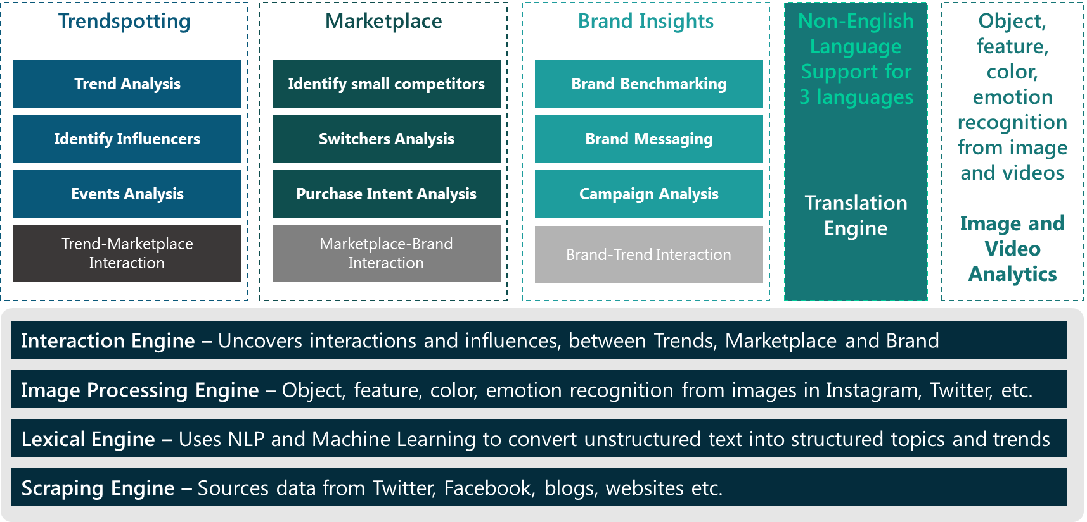
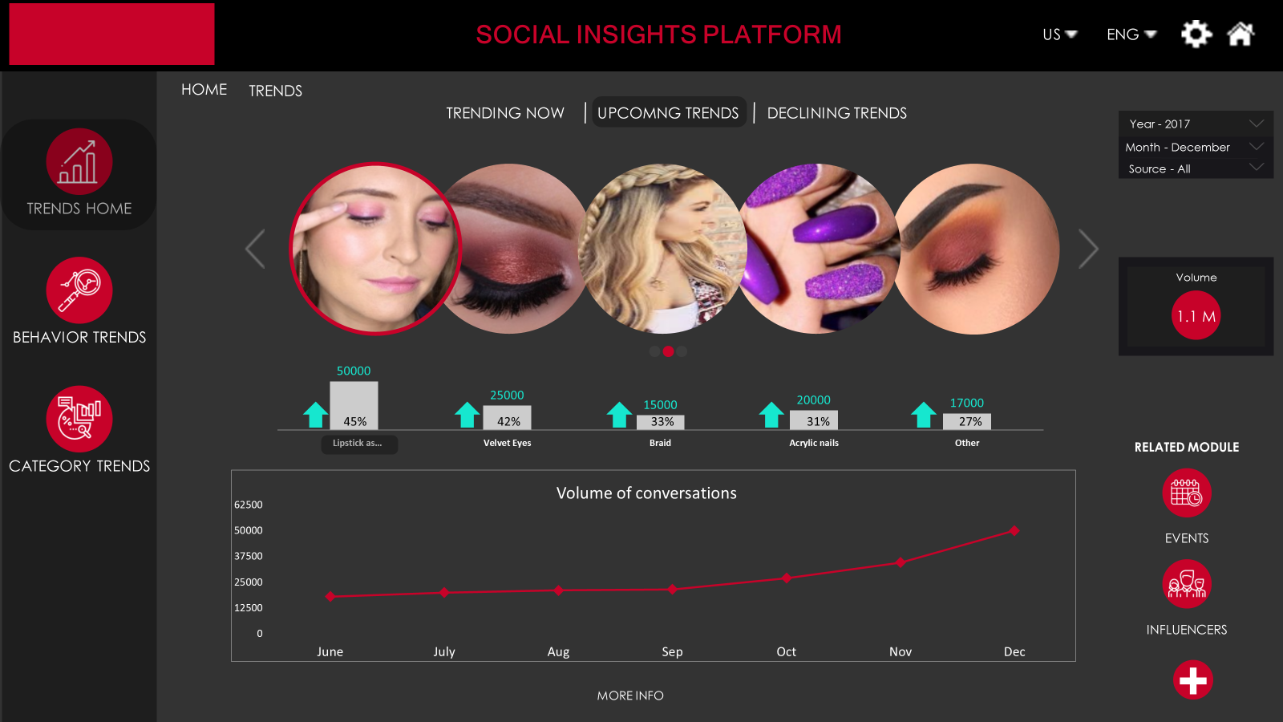
Social Insights Platform for Fashion Trends Spotting
Leading US Cosmetics Company
The Problem: Understanding the make-up and personal care needs of the women in the 18-34 age range is critical in the cosmetics industry
The “Before” State
LatentView Solution
The “After” State
Loyal consumers of the client’s cosmetics line was aging and the impression of the brand had been in steady decline among younger women for the past few years
Building a social insights platform to mine the rich data of the target demographic available in social media to spot trends, rate influencers, identify upcoming competitors, refine campaign messaging and understand drivers of purchase
Ability to score trends that could become mainstream ahead of time helped the company to improve their product launch success rate by 5% in the first 6 months
Notes:
Revlon – Trendspotting

Slide 17
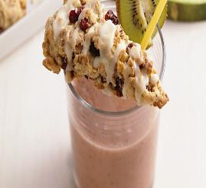







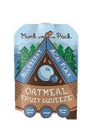


Social Media based Demand Space Analysis to drive Product Innovation
US based Food Manufacturer
The Problem: Our client wanted to understand the micro occasions that constitute a demand space in order to better evaluate product fit and understand required product innovation
The “Before” State
LatentView Solution
The “After” State
Products were designed based on Demand Spaces. Demand spaces were analysed using limited survey data leading to limited insights across demand spaces
Social media data was analysed to identify
the ‘best’ micro occasions in terms of product fit, popularity & Brand Fit along with their Emotional, Functional & Technical characteristics across demand spaces
Micro Occasion analysis was used to formulate new products in LATAM region by the client
EXISTING DEMAND SPACE VIEW
IDENTIFY MICRO OCCASIONS FROM DEMAND SPACE
DEEP DIVE INTO MICRO OCCASIONS
Gets Me Going
Midmorning Snacks
‘Superfood’ Cereal
Including superfoods like chia seeds, flax seeds ,acai berry into cereals as well as cereal bars would change the outlook of cereals for the consumers. .
Smooth
Super Chia
Cereals with Benefits
Ritual Moment
Healthy Refreshment
Cereal based Smoothies
For people who prefer to have a light but energizing and filling breakfast, cereal based smoothies with goodness of fruits can prove to be a good alternative
Always Almonds
Prevention > Cure
Gets me Going – Top Micro Occasions
Notes:
Kellogg’s Micro occasion formulation for Demand Space
Business Objective:
Kellogg’s wants to understand the micro occasion that constitute a demand space in order to better evaluate product fit and understand required product innovation
Project goals :
Identify the micromoments that constitute a demand space
Understand the emotional, functional, technical and contextual drivers of the micro occasion
Benchmark performance of Kellogg’s & competitors in micro occasion & demand spaces
LatentView Solution:
Using advanced NLP techniques identify the ‘best’ micromoments in terms of Product fit, Popularity & Brand Fit along with their Emotional, Functional & Technical characteristics
Dissect micro-occasion share of voice between Kellogg’s & Competitor brands

Slide 18










Social based Consumer Need Analysis for Product Development Roadmap
Leading Global Software Company
The Problem: Channeling true consumer needs in to product / service development is a difficult, time consuming but highly rewarding activity for any organization
The “Before” State
LatentView Solution
The “After” State
Consumer need analysis was traditionally done using surveys, focus groups and developer testing of upcoming product releases
Lexical analysis of organic social conversations extracted through a robust, brand agnostic, product development query and bucketed the consumer needs into need categories
List of un-met consumer needs enabled the product marketing team to prioritize the features to be developed and make a detailed product development roadmap
Users
Ranked Un-met Need Buckets
Detailed Requirements in un-met need bucket - 1
Product Roadmap
Consumers want more efficient and streamlined interactions with their PC
22%
22%
I want….
Efficient and streamline
interactions with PC
Feature 1: Login Screen Customizer
Priority Level: High
Status: Testing
Priority Release Date: 25 May 2017
Feature 3: VA disabler
Priority Level: Low
Status: In Development
Priority Release Date: 25 May 2017
People are looking to enhance their experience with games
17%
Create an option to automatically delete empty folders
Offer an option to save virtual desktops
Allow customization of login screen
Present an easier way to disable Virtual Assistant
Make a software to help identify and delete duplicate images in folders
Build an easier option to change between input languages
Consumers are asking for greater enhancements to fit their needs on the go
18%
People are looking for more interdependence between their devices
13%
Feature 2: Image de-duplicator
Priority Level: Medium
Status: In Development
Priority Release Date: 5 June 2017
Consumers want not just a productivity tool, but means of entertainment also
10%
Notes:
Microsoft – SIP Analysis
Business Issue:
In an effort to be customer obsessed, Windows product marketing needs to understand the wants, needs and pain points that users are organically facing in their Windows user experience on an ongoing basis
Intended Audience:
Product Engineering Team looking to improvise their current product offerings by learning about the new features that customers actually wish for most
Methodology
Approach: Brand agnostic query developed to identify unmet needs expressed organically in online social volume paired with Windows 10 conversation
Time Frame: 6 months
Tool: SIP (Social Intelligence Platform)
Findings
Online social conversation offers a rich supply of desires organically provided by users of Windows 10
Unmet customer needs fall into nine key buckets – of which the most common is the need to be more efficient in interactions with their PC followed by ways in which to enhance their gaming experience
The common thread through all unmet needs is the desire for Windows to fit the customers’ lifestyle, whether that be through entertainment, productivity, or customization

Slide 19





Precise Forecasting of Demand for Jewelry SKUs
World’s 3rd Largest Jewelry Manufacturer
The Problem: Accurate demand forecasts for new and existing SKU’s is essential in a vertically integrated supply chain for high value products
The “Before” State
LatentView Solution
The “After” State
Lack of consensus on demand forecast across different business functions and no centralized category level forecast was further complicated by the frequent introductions of new products every year
Generated baseline forecasts for 3000 SKU’s using multivariate forecasting techniques and driving consensus among demand planners. Automated new SKU forecasts using similarity indices to identify most similar old SKUs
Improved overall demand forecast accuracy by 13% and availability of SKU level forecasts helped reduce supply planning costs by 2%
Existing SKUs
New SKUs
Fit the models from the subset identified above to the in-sample data and collect statistics on the out-sample
Calculate similarity indices for new SKUs to identify most similar old SKUs
Add following variables to the data
Subset Data
Determine if the time series requires any additional transformations
Net Weight
Weight Gold/Silver
DNA Metal
US Retail Sale price
DNA Stones
DNA Colour
Choose the model with the best accuracy to fit the whole range of data
Choose the model with the best accuracy to fit the whole range of data
Repeat the process for all SKU’s
Identify and flag poor performing models for manual corrections
Clustering of SKUs
Use business inputs to fine tune models
ARIMA
STLF
Neural Networks
Croston’s
Tbats
Prophet
K- Prototypes
PAM
Notes:
Pandora – Demand Forecasting

Slide 20
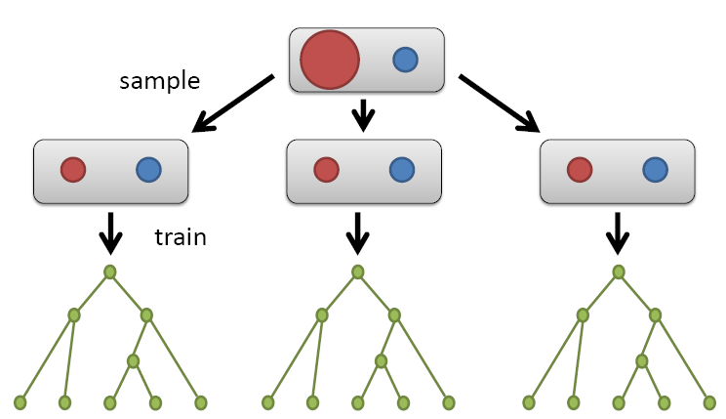
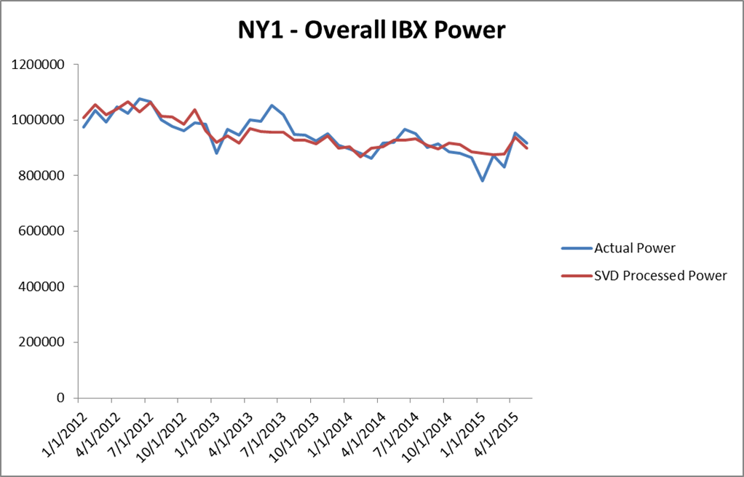
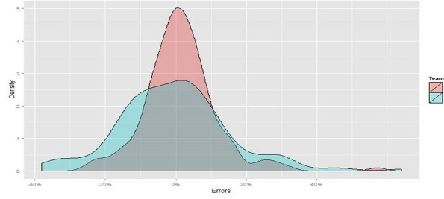

Accurate Power Consumption Forecasting for Successful Hedging
Leading Global Technology Infrastructure Provider
The Problem: Customer Lifetime Value of existing customers is nearly twice that of new customers and hence retention is key to profitability
The “Before” State
LatentView Solution
The “After” State
Power Consumption at its data centres is the largest operational expense for the client
And low accuracy of existing power forecasts led to expensive power prices
By utilizing the historical power consumption data of data centres and data around the customers of the client, provided accurate power consumption forecasts which is key in making the “Hedge” successful
Regularized random forests & the “SVD + Univariate Forecasts” combined to improve forecast accuracy enabling potential Savings between 3 - 5 Million
Overall Data
Center Power
Regularized Random Forests
Predicted Customer Power
Historically learnt
Overhead Power
Forecasted Overall
IBX Power
Customer Power Data
Overhead Power
Customer features |  |  |  | Customer Power (Historical)
+
=
+
Customer Power
Singular Value Decomposition
Actual Power
SVD Processed Power
LatentView
Existing Solution
Distribution of Forecast Errors
Notes:
Equinix – Power Forecasting

Slide 21


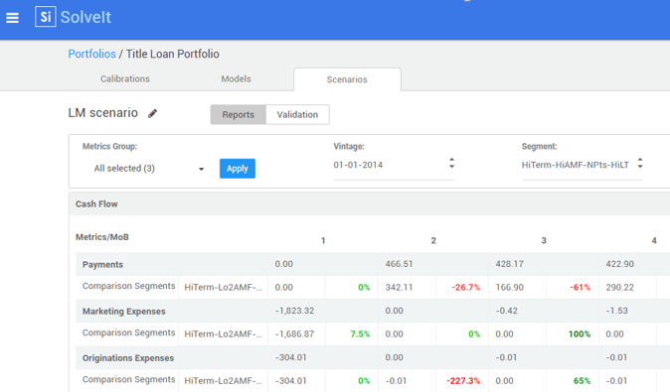
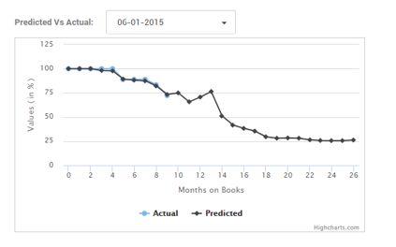


Machine Learning driven Customer Lifetime Value Analysis
SolveIt - Latent View proprietary platform
The Problem: Understanding customer LTV values to optimize their customer acquisition and retention strategies is happening in a sub-optimal manner.
The “Before” State
LatentView Solution
The “After” State
Traditional approach to computing the value of a customer relies on looking at short-term trends in behavioral patterns and misses the potential long-term benefits of the customer relationship
SolveIT, an inhouse product provides an intuitive, easy-to use, fast and flexible software platform to help define, calculate and manage customer lifetime value using a machine learning based approach
Customer Lifetime Value computed using SolveIT has helped companies in re-calibrating retention strategies and acquisition initiatives to the extent of reducing churn by 4% on average and improving customer acquisition by 5-8%
Defining Models and Drivers
Reporting & Analytics
APPROACH
REPORTING
Calibrating Drivers
Managing Scenarios
Notes:
SolveIT – LatentView Proprietary CLV Platform

Slide 22
Increasing Sign-ups through Attribution Modeling
Global business and financial software company
The Problem: Typically credit for enrollments/sign ups is attributed to the last touch point ignoring the impact of offline marketing channels.
The “Before” State
LatentView Solution
The “After” State
Client gets its sign ups from online marketing channels but there is an indirect impact of offline channels like TVs on driving web channels. Client lacks a scientific approach to measure the cross channel impact of TV ads in driving sign ups.
A Triangulation Technique was carried out to measure the impact of TV ads followed by a Two regression-modeling approaches (Top-down – Aggregate Level and Bottoms-up Channel wise) and cross-tab analysis was conducted to identify the impact of TV advertisements.
Helped business change their strategic decision to continue investing aggressively through this channel since TV stands out as an important touch point in influencing signup decision.
New strategy helped increase the overall sign ups by 16%.
16%
direct + indirect effects
Sign ups
Notes:
Intuit – Attribution Modeling
Business Context
Measure the contribution and cross channel impact of TV ads in driving signups across all web channels
Web Channels
Direct (Intuit.com, QB.com, Payroll.com, QBOE.com)
Organic Search, PPC
Other: Accountants Direct, Affiliate, Display, Mobile, OEM, Payroll.com, Start Another Company and Telesales
LatentView Solution
A Triangulation Technique was carried out to measure the impact of TV ads
Two regression-modeling approaches (Top-down – Aggregate Level and Bottoms-up Channel wise) and cross-tab analysis was conducted to identify the impact of TV advertisements.
The hypothesis was that TV drove sign-ups through channels (and very little through Direct attribution)
Business Benefits
1 in every 6 signups can be attributed to TV in the period and TV stands out as an important touch point in influencing signup decision
Helped business change their strategic decision (which was initially to pause TV advertising) to continue investing aggressively through this channel
TV’s influence in driving organic signups is a clear indicator of the very wide audience it can reach

Slide 23
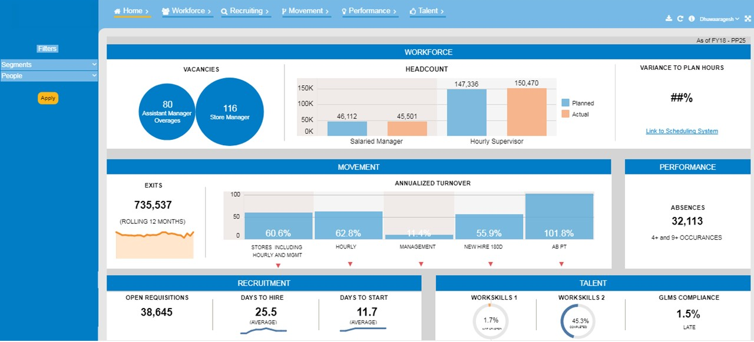
“Corporate to Store” Connect Through Integrated People Metrics
US based Retail chain
The Problem: Global HR executive did not have a consolidated view of all workforce related metrics, leading to slow decision making
The “Before” State
LatentView Solution
The “After” State
HR metrics were analysed in silos for each market by using manual reports. This did not provide a holistic view of the performance and therefore making org wide HR decisions was a challenging task
Build an intuitive, actionable visualization platform that provides insights across Head count, Recruitment, Movements, Performance and Talent metrics with a granularity from Market level to an individual store level
The process of Global HR decision making was expedited with decisions being taken at a much faster rate saving almost 30% in analysis and turn-around time
Web wrapper around Tableau dashboard
User ID based access control
Multiple Device compatibility
(Mobile, Desktop, Tablet)
Data download functionality
Notes:
Walmart – People Dashboards

Slide 24

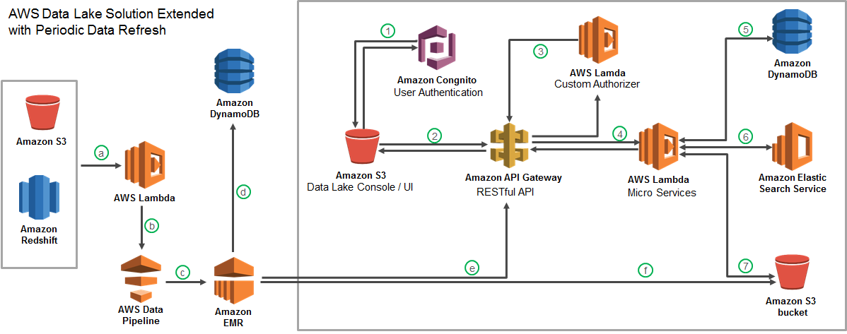



Cloud based data lake to enhance Analytics Operations
Largest Food Distributor in the US
The Problem: Ageing legacy Business Analytics Infrastructure with high cost of ownership slowing down realizable analytics value
The “Before” State
LatentView Solution
The “After” State
Business users faced significant delays in accessing and analyzing data and had difficulty in handling large volumes of data for analytics
Migrated 60TB of data from legacy systems into a cloud based data lake with extended periodic data refresh which supports reporting and advanced analytics solutions
Reduced cost of ownership and increased throughput of cloud hosted analytics solutions
Recommendation Engine
Order Anomaly Detection
Product Substitution
Revenue Management Use Cases
Notes:
Sysco – Data Engineering – SEED Platform

Slide 25












Data Harmonization for Efficient Digital Supply Chain
World’s Largest Entertainment production company
The Problem:
For digital content that contributes $4 billion in revenue, the weak link in the supply chain is the nature of data pipeline which in the correct state is rigid & fragmented
The “Before” State
LatentView Solution
The “After” State
The supply chain starting from digital content request to going live is tracked using multiple silo data sources and requires skilled executives to monitor for revenue leaks
Built an data ecosystem from multiple disjointed unstructured and structured data sources by leveraging AWS cloud platform for big data, thus providing a monitoring platform
The solution helped in ensuring on-time delivery of the digital contents and thus, saved half a million dollar per year from revenue leaks
SQL Server
DMS
(ongoing replication)
S3 buckets
(encrypted)
Redshift
MarkLogic
GLUE
Tableau Server
Internet
Azure
Lambda
EC2 (Bastion Host)
DBA
Notes:
Warner Bros – Digital Supply Chain (Data Engineering)

Slide 26





Survey Design – Estimating Purchase Intent for Toys & Games
Leading online marketplace
The Problem: Ineffective survey design can result in poor understanding of customer’s purchase intent and will have a cascading negative impact on quality of business decision making
The “Before” State
LatentView’s Solution
The “After” State
The kids’ toys, games for adults and collectible toys category was expected to be an important segment during the holiday season. Client wanted to understand purchase intent and where their brand was placed vis-à-vis competitors.
A survey designed to capture data related to size of market, purchase intention and purchase drivers. A regression framework was formulated to understand purchase intention and correspondence analysis was done for brand perception
Identification of customer and product segments with maximum potential in identified product categories. Appropriate promotion campaigns were run to convert purchase intention to sales.
Buyer’s demographics
Purchase factors | Client brand’s relative strength / weakness | Strong competitors
Factor 1 |  | Brand 2
Factor 2 |  | Brand 4
Factor 3 |  | Brand 1, 3
Factor 4 |  | Brand 6
Factor 5 |  | Brand 5
Segmentation
Past Purchase Behavior
Market Sizing
Purchase Intention
Drivers of Purchase
Purchase Drivers
Brand perception
Questionnaire Design & Data Collection
Estimating Purchase Intention
Insights
Notes:
eBay – Online Survey Design (Primary Marketing Research)

Slide 27
Thank you

